Slide 1
String Searching

Slide 2

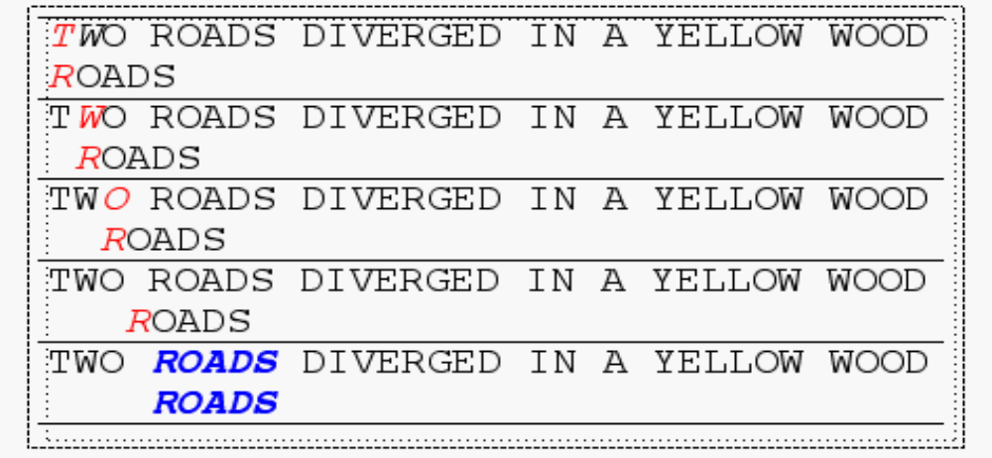
Brute Force
The Brute Force algorithm compares the pattern to the text, one character at a time, until unmatching characters are found
Total number of comparisons: M (N-M+1)
Worst case time complexity: O(MN)

Slide 3
Rabin-Karp
If comparing pattern with text to see if it is the same takes O(1) then brute force would take O(n).
If we knew the integer value of the pattern and integer value of every substring of text of size m then comparing pattern with text substring is O(1).
Issues:
1. What could be the integer representations of strings.
2. The above assumes that finding integer values of substrings is constant time
3. It assumes that strings are short and will give short integers that fit into registers so that comparison operations on the integers are O(1). What if long integers?

Slide 4
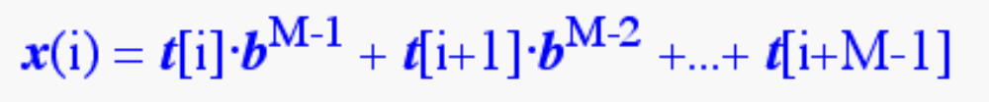
Consider an M-character sequence as an M-digit number in base b, where b is the number of letters in the alphabet. The text subsequence t[i .. i+M-1] is mapped to the number
Intuition: The string ‘12345’ has length 5. The corresponding number would be:
1.10⁴ + 2.10³ + 3.10² + 4.10 + 5

Slide 5
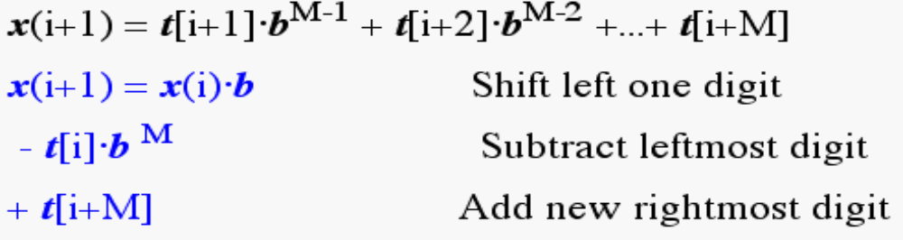
Given x(i) we can compute x(i+1) for the next subsequence t[i+1 .. i+M] in constant time

Slide 6
Issue 3
It assumes that strings are short and will give short integers that fit into registers so that comparison operations on the integers are O(1). What if long integers?
Use a hash function which is mod q for large prime q. This will ensure that integer numbers are small. However, now we don’t have the integer to be unique to a substring. Instead we have a hash value which might be same for two dissimilar substrings.
Different hash values mean substrings are different but similar hash value would need a brute force comparison of pattern with that substring.

Slide 7
Rabin-Karp Mods
If M is large, then the resulting value will be enormous. For this reason, we hash the value by taking it mod a prime number q.
Note;
[(x mod q) + (y mod q)] mod q = (x+y) mod q
(x mod q) mod q = x mod q

Slide 8
Earlier:
Now:
h(i)=((t[i]⋅ bM-1 mod q) +(t[i+1]⋅ bM-2 mod q) + ...
+(t[i+M-1] mod q))mod q
Earlier:
Now: h(i+1) =( h(i) ⋅ b mod q
-t[i] ⋅ b^{M} mod q
+t[i+M] mod q ) mod q

Slide 9
Rabin-Karp
The Rabin-Karp string searching algorithm calculates a hash value for the pattern, and for each M-character subsequence of text to be compared.
If the hash values are unequal, the algorithm will calculate the hash value for next M-character sequence.
If the hash values are equal, the algorithm will do a Brute Force comparison between the pattern and the M-character sequence.
In this way, there is only one comparison per text subsequence, and Brute Force is only needed when hash values match.
.

Slide 10
The Knuth-Morris-Pratt Algorithm

Slide 11
The KMP Algorithm
Keeps track of information gained from previous comparisons.
T: a b x a b x a b b x c y b ……
P: a b x a b b x c y
Find the largest text suffix matched so far that is same as pattern prefix
Find the longest prefix of the pattern P[0,..,j] that is also a suffix of P[0,..,j]
For each index position of pattern from 1 to j, compute the prefix index position from which one can continue checking.

Slide 12
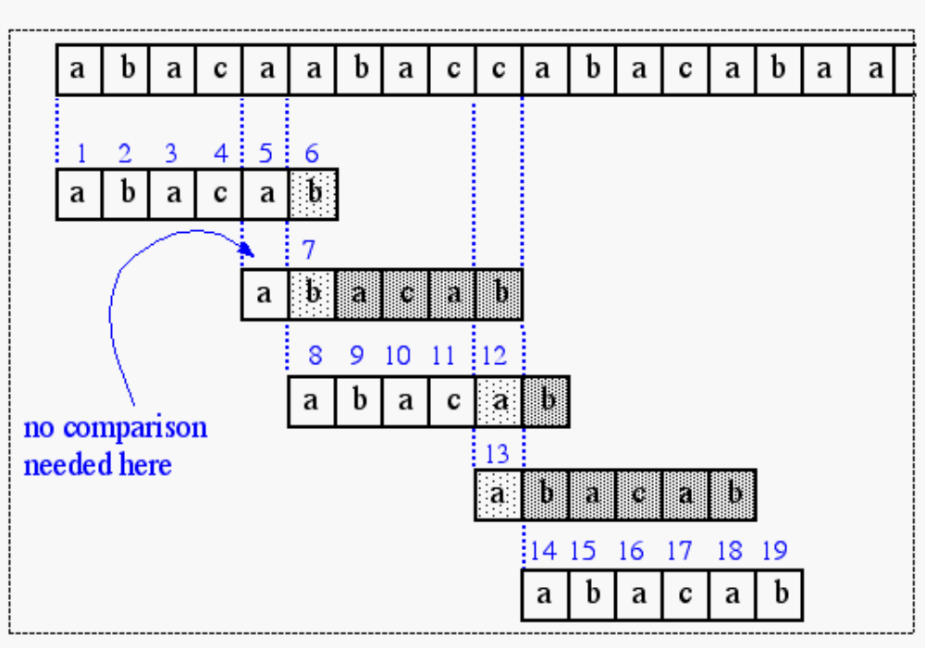


Slide 13
The KMP Algorithm
When S[0…i]=T[x-i-1….x-1] but
S[i+1] !=T[x] then
we want to compare T[x] with some location S[j].
Pre Compute function F[i] such that, F[i]=j when the longest suffix of S[0,…i] which is equal to its prefix is S[0,…j-1].
Hence we would next like to compare the location that S[i+1] was trying to match with the text with S[j] and hope to find a match

Slide 14
Incase of a mismatch :
Do not restart comparison at next location
Instead precompute how much to shift by whenever there is a mismatch at a particular location of pattern

Slide 15
The KMP Algorithm
For P[m]; m>=1
compute the largest prefix index k s.t P[0…k-1] overlaps with [m-k+1..…m]
if no overlap then mark as 0
0 1 2 3 4 5 6 7
A b c d a b c a
0 0 0 0 1 2 3 1
Fill in the values
A a b a a b a a a

Slide 16
The KMP Algorithm
If there is a match till i (mismatch at i+1) then, h[i] is the index next location should be matched with
0 1 2 3 4 5 6 7
A b c d a b c a
0 0 0 0 1 2 3 1
Fill in the values
A a b a a b a a a

Slide 17
The KMP Algorithm
For each index position of patter from 1 to j, compute the prefix index position from which one can continue checking.
I:0 1 2 3 4 5 6 7 8
a a b a a b a a a
V:0 1 0 1 2 3 4 5 2
0 1 2 3 4 5
a b a c a b
0 0 1 0 1 2

Slide 18
0 1 2 3 4 5 6 7 8 9 10 11 12 13 a b c a b c d a b c a b c a
0 0 0 1 2 3 0 1 2 3 4 5 6 4
Suffix till i-1 is same as suffix of P[i-j,…..i-1] that is prefix same as suffix of P[0,…..j-1] that is a prefix.
A[j-1] gives you the index right after the suffix of P[0,…..j-1] matches with prefix. If P[A[j-1]]!=P[i] then
We need to look for suffix of P[0,…..j-1] which is prefix.
Same as look for suffix of P[0,……., (A[j-1]-1)] which is prefix and so on.

Slide 19
The KMP Algorithm (contd.)
the KMP string matching algorithm: Pseudo-Code
Algorithm KMPMatch(T,P)
Input: Strings T (text) with n characters and P
(pattern) with m characters.
Output: Starting index of the first substring of T
matching P, or an indication that P is not a
substring of T.

Slide 20
Algorithm
vector<int> PrefixFunction(string S)
{
vector<int> p(S.size());
int j = 0; f[0]=0;
for (int i = 1; i < (int)S.size(); i++)
{
while (j > 0 && S[j] != S[i])
j = f[j-1];
if (S[j] == S[i]) j++;
f[i] = j;
}
return p;
}

Slide 21
a b a c a b
1 1 2 1 2 3
Note:indices starting from 1
No comparison needed here

Slide 22
Algorithm
f ← KMPFailureFunction(P)
i ← 0
j ← 0
while i < n do
if P[j] = T[i] then
if j = m - 1 then
return i - m - 1 {a match}
i ← i + 1
j ← j + 1
else if j > 0 then {no match, but we have advanced}
j ← f(j-1) {j indexes just after matching prefix in P}
else
i ← i + 1
return “There is no substring of T matching P”

Slide 23
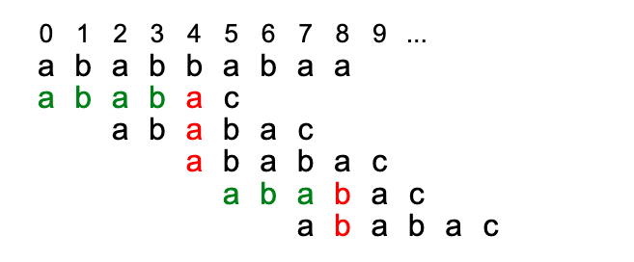
The KMP complexity
The inner while loop of the preprocessing algorithm decreases the value of j by at least 1, since b[j] < j. The loop terminates at the latest when j = 0, therefore it can decrease the value of j at most as often as it has been increased previously by j++. Since j++ is executed in the outer loop exactly m times, the overall number of executions of the inner while loop is limited to m. The preprocessing algorithm therefore requires O(m) steps.
Similarly the searching algorithm requires O(n) steps. The comparisons (green and red symbols) form "stairs". The whole staircase is at most as wide as it is high, therefore at most 2n comparisons are performed. For k steps you match in pattern, you can go back at most k steps and again start from there

